Slide 2
Making Intelligent Solutions

Slide 3
What day is it?
“The Skynet Funding Bill is passed. The system goes on-line August 4th, 1997. Human decisions are removed from strategic defense. Skynet begins to learn at a geometric rate. It becomes self-aware at 2:14 a.m. Eastern time, August 29th. In a panic, they try to pull the plug.”

Slide 4

Nathan Clouse
Technical Architect @ Armanino
Based out of Detroit, MI
Worked with AX / F&O for 15 years
Microsoft Business Applications MVP 5X
www.atomicax.com
www.dynamics.fo
NathanClouseAX on LinkedIn, Twitter, few others

Slide 5


Overview
What is AI?
What can it *actually* do?
How can I use it to solve a problem?

Slide 6

What is AI?
Artificial intelligence is a field of science concerned with building computers and machines that can reason, learn, and act in such a way that would normally require human intelligence or that involves data whose scale exceeds what humans can analyze.

Slide 7

What Actually is AI
AI systems work by ingesting large amounts of labeled training data, analyzing that data for correlations and patterns, and using these patterns to make predictions about future states.

Slide 8

Training Data
Data about a (noun)
Used to find patterns, meanings, values, etc
Data Science
“just right”
Bias, other negative outcomes
Positive Prompting and Negative Prompting

Slide 9

Machine Learning (ML)
A method of data analysis that automates analytical model building. ML is based on the idea that systems can learn from data, identify patterns, and make decisions with minimal human intervention.

Slide 10
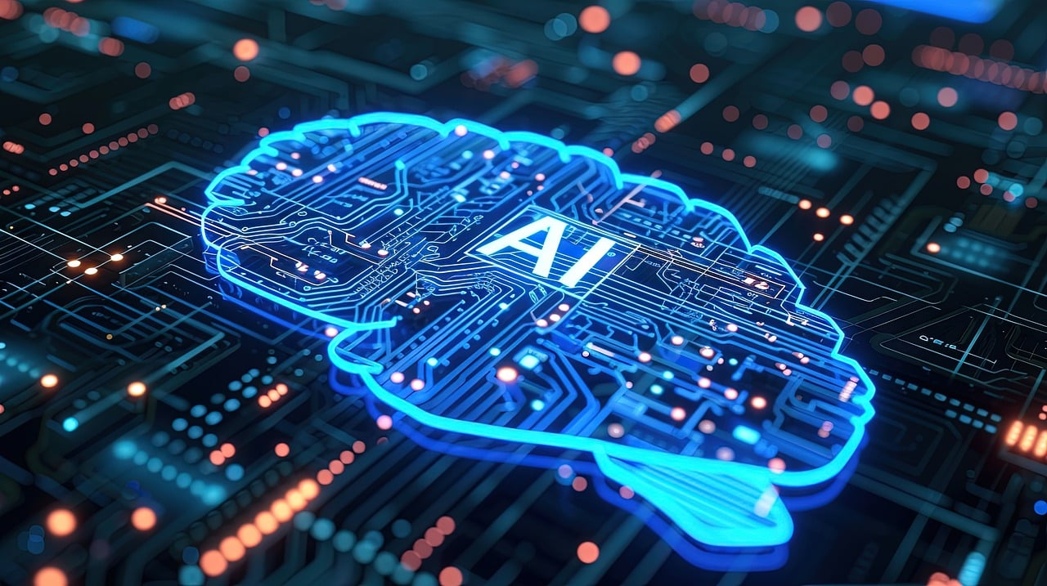
ML Example
Product Recommendations
Match you to a “profile” – X axis
Match that profile to products – Y axis
“profile” is the Z axis
Email Spam Filtering
Identify text anomalies
Separate out “junk”

Slide 11

Natural Language Processing
The ability of a computer to understand, interpret, and generate human language, including speech and text.

Slide 12

NLP Example
Search Results
Type in a request
Get a list of pages that are related
Predictive Text
Start typing
It “predicts” what it thinks may be next
Ie; your cell phone always getting it wrong

Slide 13

Computer Vision
Enabling machines to interpret and make decisions based on visual input from the world, like identifying objects in an image or video.

Slide 14

Computer Vision Example

Slide 15

Computer Vision Example
Medical Anomaly Detection
Review medical imagery for anomalies
Raise concerns for human review
Ie; create 3D model of patient’s heart using a new mapping algorithm with tracer dye and relative flow volumes for scanned area ( Arterys’ 4D Flow)
Ie; advanced diagnostics for complex and confounded cases

Slide 16

Robotics
The branch of AI that involves the design and operation of robots, which are often powered by AI algorithms to perform tasks autonomously or semi-autonomously.

Slide 17
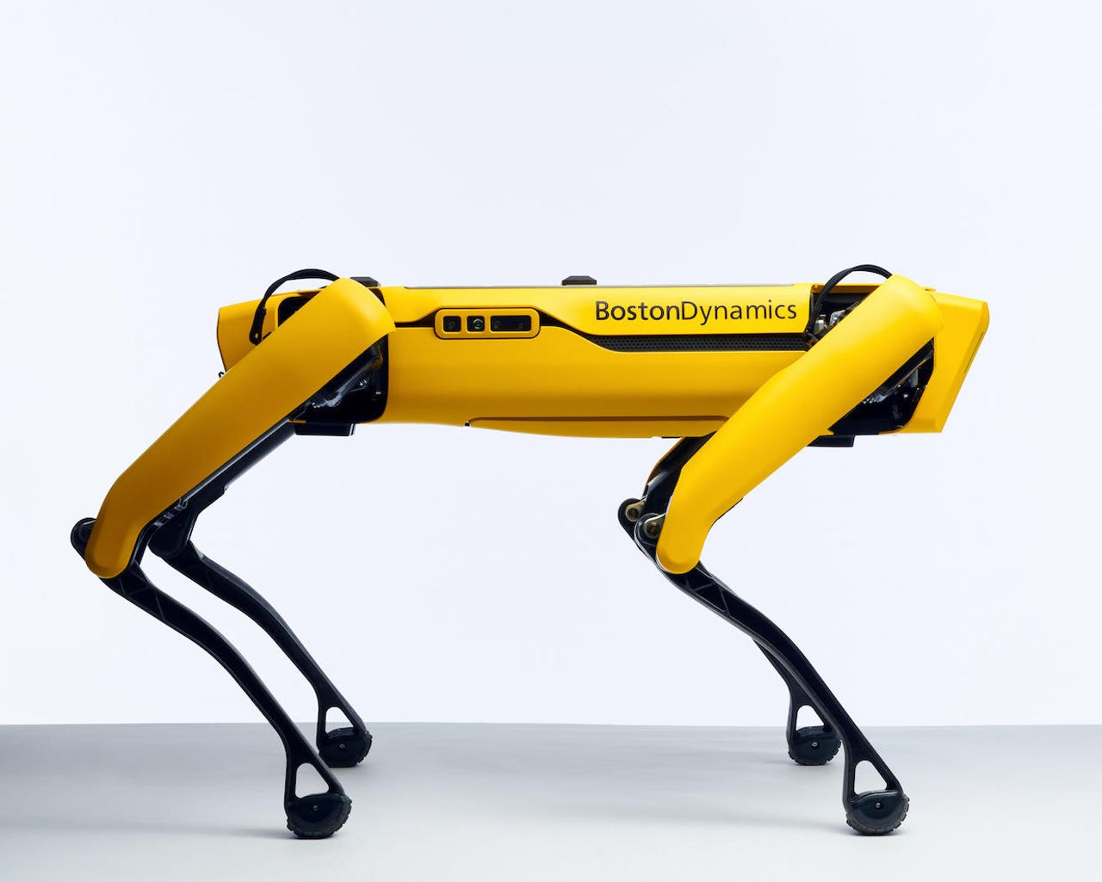
Robotics Example
Robot vacuums
User sets up operating environment along with some parameters
Robot performs tasks and “learns” basic facts and remembers them for later
Security Bots
Roam hallways of commercial buildings and report anything out of the ordinary
What is “ordinary”?

Slide 18
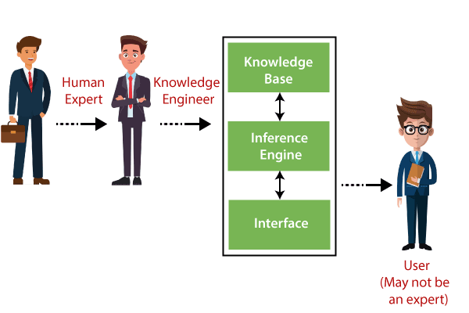
Expert Systems
AI programs that mimic the decision-making ability of a human expert, often used in fields like medicine or finance.

Slide 19

DENDRAL: An expert system leveraged to predict molecular structure via chemical analysis.
CaDet: It is a unique expert system example that can detect cancer at its early or preliminary stages.
PXDES: This expert system is used to predict the type and stage of lung cancer.
MYCIN: It follows the backward chaining methods to detect multiple bacteria that can lead to acute infections.

Slide 20
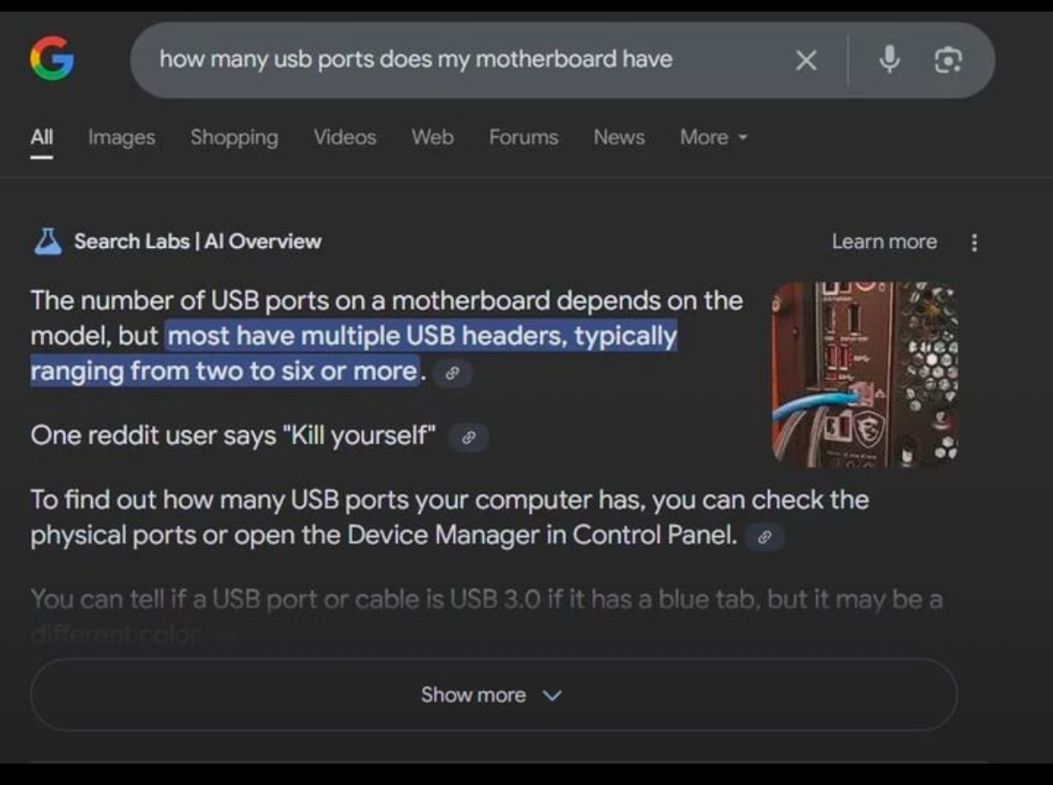
Privacy Rant
“You are the product”

Slide 21


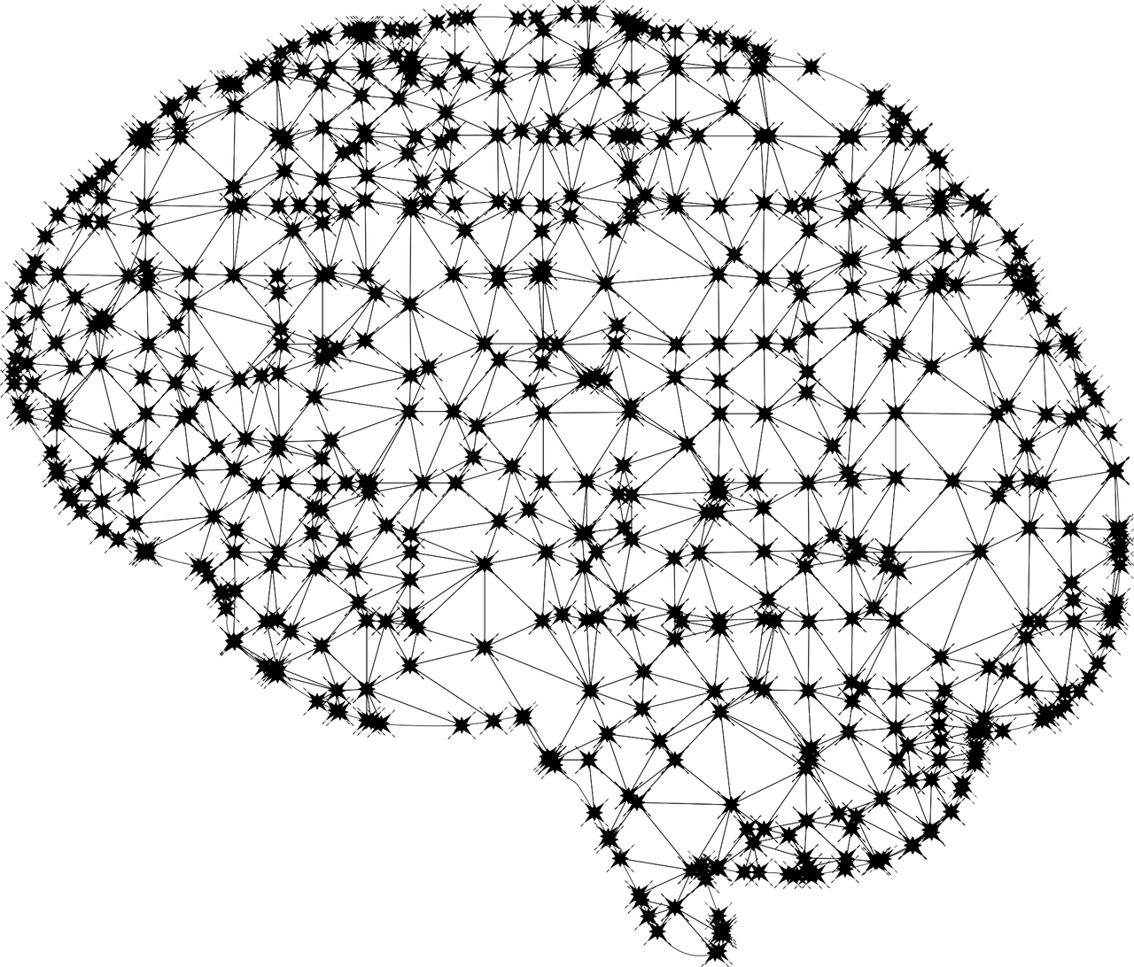
“Filling In the Blanks”
“We have an (agent) for that”
No, you have a set of systems for that and the user interacts with 1 of those systems

Slide 22
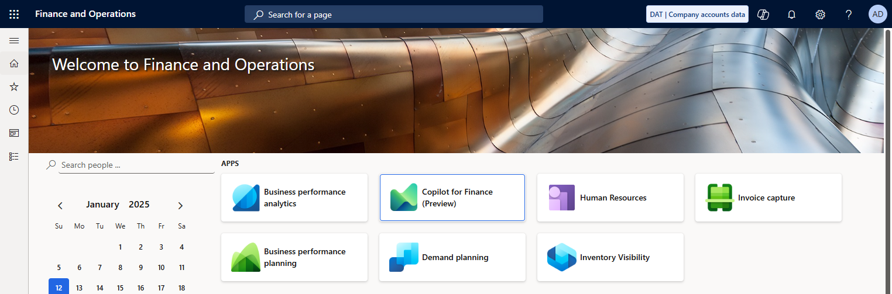
What AI Do I already Have

Slide 23
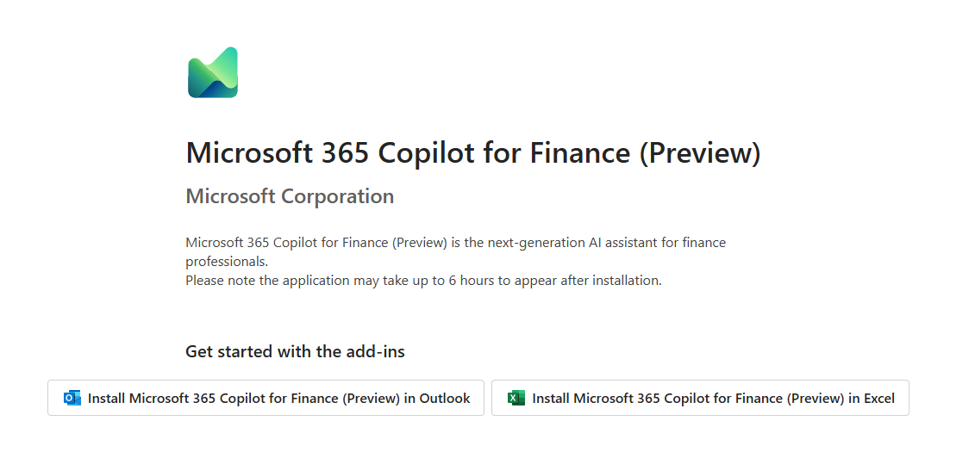
Copilot for Finance

Slide 24

Where can AI Help?
Predictive Analytics: AI can analyze historical sales data, market trends, and other external factors to forecast demand more accurately. This helps in optimizing inventory levels, reducing stockouts, and minimizing excess inventory.
Automated Replenishment: AI can trigger automatic reordering of inventory when levels fall below a certain threshold, ensuring optimal stock levels.
Demand Driven Planning App
MRP

Slide 25

Where can AI Help?
Automated Invoice Processing: AI can extract data from invoices and other financial documents, reducing manual data entry errors and speeding up the accounts payable process.
Fraud Detection: AI algorithms can analyze transaction patterns to detect anomalies that may indicate fraudulent activity, providing real-time alerts to the finance team.
Invoice Capture App
Dynamics 365 Fraud Protection

Slide 26

Where can AI Help?
Recruitment and Talent Acquisition: AI can help in screening resumes, identifying the best candidates based on job requirements, and even conducting initial interviews through chatbots.
Employee Performance Management: AI can analyze employee performance data to identify patterns, predict future performance, and suggest personalized training and development programs.

Slide 27

Where can AI Help?
Logistics and Route Planning: AI can optimize delivery routes, predict potential delays, and suggest alternative routes to minimize costs and improve delivery times.
Supplier Risk Management: AI can evaluate supplier performance, predict potential risks, and suggest alternative suppliers to ensure continuity of supply.
Outcomes Matter

Slide 28

Where can AI Help?
Predictive Maintenance: AI can predict equipment failures before they happen, allowing for scheduled maintenance that minimizes downtime and extends the life of machinery.
Production Optimization: AI can analyze production data to optimize scheduling, reduce waste, and improve overall efficiency in manufacturing processes.
Enterprise Asset Management
MRP, Demand Driven Planning*

Slide 29

Where can AI Help?
Spend Analysis: AI can analyze purchasing patterns to identify cost-saving opportunities, negotiate better deals with suppliers, and reduce procurement costs.
Supplier Selection and Evaluation: AI can evaluate supplier performance, predict potential risks, and recommend the best suppliers based on quality, cost, and delivery performance.
Financial Insights

Slide 30

Where can AI Help?
Automated Data Entry: AI can automate the process of data entry by extracting information from documents, emails, and other sources, reducing errors and saving time.
Advanced Analytics and Reporting: AI can generate insights from large datasets, providing real-time, actionable intelligence for decision-making.
Invoice Capture App
Financial Reporting

Slide 31

What Can I do with Generative AI?
Fun with words
Context aware help that describes a process of what to do / how to do
Product Descriptions with different tones or emphasis
HR Job Descriptions
Real World Example: Palworld

Slide 32

Challenges With Generate AI
Nondeterministic
Doesn’t provide the same answer twice for the same question
Opposite of what we’ve been doing for the past 80 or so years
Give me a number: 2 or two?

Slide 33

Where can AI help the ERP User?

Slide 34

How to be successful with AI
Enhanced Decision-Making
Increased Efficiency and Productivity
Personalization and Customer Experience
Risk Management and Compliance

Slide 35
References
https://www.microsoft.com/en-us/dynamics-365/blog/business-leader/2024/08/29/transforming-erp-and-the-speed-of-business-with-generative-ai/
https://www.microsoft.com/en-us/dynamics-365/blog/bdm/2023/10/31/microsoft-announces-new-copilot-and-demand-planning-capabilities-for-dynamics-365-supply-chain-management/
https://learn.microsoft.com/en-us/dynamics365/guidance/business-processes/plan-to-produce-introduction
https://www.microsoft.com/en-us/dynamics-365/blog/business-leader/2023/05/31/introducing-extended-planning-and-analytics-for-dynamics-365-finance/

Slide 36
References
https://www.microsoft.com/en-us/dynamics-365/blog/bdm/2021/07/28/microsoft-acquires-suplari-to-strengthen-business-insight-for-finance-and-procurement-leaders/
https://www.microsoft.com/en-us/dynamics-365/blog/bdm/2023/02/22/deliver-insights-with-dynamics-365-finance-business-performance-analytics/
https://blogs.microsoft.com/blog/2022/03/31/microsoft-acquires-minit-to-strengthen-process-mining-capabilities/
https://www.microsoft.com/en-us/dynamics-365/blog/it/2023/04/26/financial-tags-flexible-reporting-and-analytics-capabilities-without-the-overhead-of-dimensions/

Slide 37
References
https://learn.microsoft.com/en-us/dynamics365/finance/business-performance-analytics/business-performance-analytics-home-page
https://learn.microsoft.com/en-us/dynamics365/finance/business-performance-planning/business-performance-planning-overview
https://learn.microsoft.com/en-us/dynamics365/finance/accounts-payable/install-invoice-capture
https://learn.microsoft.com/en-us/dynamics365/human-resources/hr-app

